Slide 1
Military Veteran Hiring Aid
September 2018

Slide 2
Contents
1
Why Hire Veterans?
2
Military Branch Overview
3
Military Experience Levels
4
Military Ranks
5
Military Functions
6
Military Status & Discharge Definitions
7
Job Transition Timeline
8
Additional Resources

Slide 3
Why Hire Veterans?

Slide 4
10 Reasons to Hire Military Veterans
Veterans come from a previous culture built for mission accomplishment in mind.
Veterans have ingrained leadership talents.
Veterans take their responsibilities seriously.
Intuition is a skill, and the military teaches it.
Military people will openly tell you when something is wrong.
Military people will get the job done.
When given the necessary support, Veterans are extremely capable.
Veterans are independent.
Military personnel know the meaning of hard work.
The government pays for Veteran education.
Veteran hiring tax credit information
Team, Military & Defense. “10 Reasons Companies Should Hire Military Veterans.” Business Insider, Business Insider, 11 Nov. 2016, www.businessinsider.com/reasons-companies-should-hire-military-veterans-2016-11.

Slide 5
Current State
2,000,000 CA Veterans
Over 16,000 separate from the military per month
Only 3% of BSC employees are Veterans
Minimal/Non-existent military outreach programs
No military talent pipeline in place
Source: calvet.ca.gov
(All numbers are approximate)

Slide 6
Military Branch Overview

Slide 7
Military Branches
Branch | Core Values | Responsibilities
Army | Loyalty, Duty, Respect, Selfless Service, Honesty, Integrity, Personal Courage | Main U.S. ground force
Air Force | Integrity, Service Before Self, Excellence | Defends the U.S. in both air and space
Navy/Marine Corps | Honor, Courage, Commitment | Navy – Defends the freedom of the seas Marine Corp – Specializes in amphibious operations
Coast Guard | Collaboration, Transparency, Selfless Service, Innovation, Informed Decision Making | Specializes in the defense of U.S. ports and waterways, including drug interdiction and rescue operations.

Slide 8
Military Experience Levels

Slide 9
Middle and Upper Management
Category | Grade Range | Years of Military Experience | 4-Year College Degree? | Supervisory/ Managerial Experience? | Key Responsibilities | Key Characteristics
Middle and Upper Management
Junior Officer (JMO) | O1 – O3 | O1 – O2 = <4 years O3 = 9 years | Yes (Usually highly competitive college programs or advanced degrees) | Yes (40 – 150 people) | Operations and small unit leadership | Superior communicator Decision maker Public Affairs Technology and logistics savvy Fiscal acumen Policy Maker Strategic Planner
Mid-Grade Officer | O4 – O5 | 10 – 22 years | Yes | Yes (750 – 1000 people) | Operations and strategic planning
Senior-Grade Officer | O6 - O10 | 23 + years | Yes | Yes (1000+ people) | Large scale organizational expertise

Slide 10
Specialized Management
Category | Grade Range | Years of Military Experience | 4-Year College Degree? | Supervisory/ Managerial Experience? | Key Responsibilities | Key Characteristics
Specialist vs. General or “Unrestricted Officer”
Junior Warrant Officer | WO1 – WO2 | 2 – 7 | Maybe | No | Various, ranging from specialized training to pilot, etc… | Technical expertise Training expertise Advisors Combat leaders
Mid – Grade Warrant Officer | WO3 – WO4 | 8 – 18 | Likely | No
Senior Warrant Officer | W05 | 19+ | Likely | No

Slide 11
Leads & Independent Contributors
Category | Grade Range | Years of Military Experience | 4-Year College Degree? | Supervisory/ Managerial Experience? | Key Responsibilities | Key Characteristics
Technicians, Skilled Labor, First Line Managers (85%)
Junior Enlisted | E1 – E3 | < 3 Years | Maybe | No | Core set of military experiences, education & training | Takes initiative Dependable Performs under pressure Able to work independently in absence of leader

Slide 12
Lower Level Management / Supervisors
Category | Grade Range | Years of Military Experience | 4-Year College Degree? | Supervisory/ Managerial Experience? | Key Responsibilities | Key Characteristics
‘Non – Commissioned’ Officers (NCO)
Mid – Grade Enlisted (Junior NCO) | E4 – E6 | 3 – 10 years | Maybe | Yes (5 – 25 people) | Team leadership | Operational Leadership Teamwork Problem Solving Technology and logistics savvy Fiscal acumen
Senior Enlisted (Staff NCO) | E7 – E9 | 10+ years | Yes | Yes (40 – 120+ people) | Team leadership and strategic planning

Slide 13
Military Ranks

Slide 14
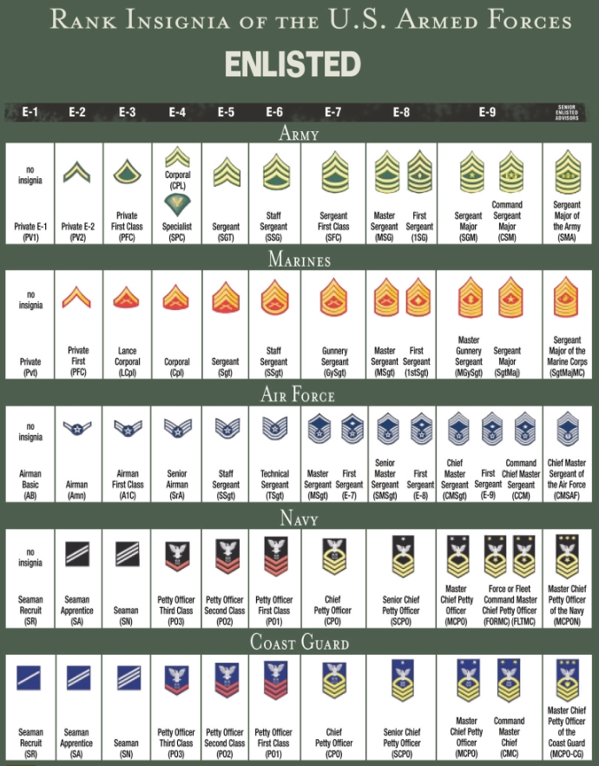
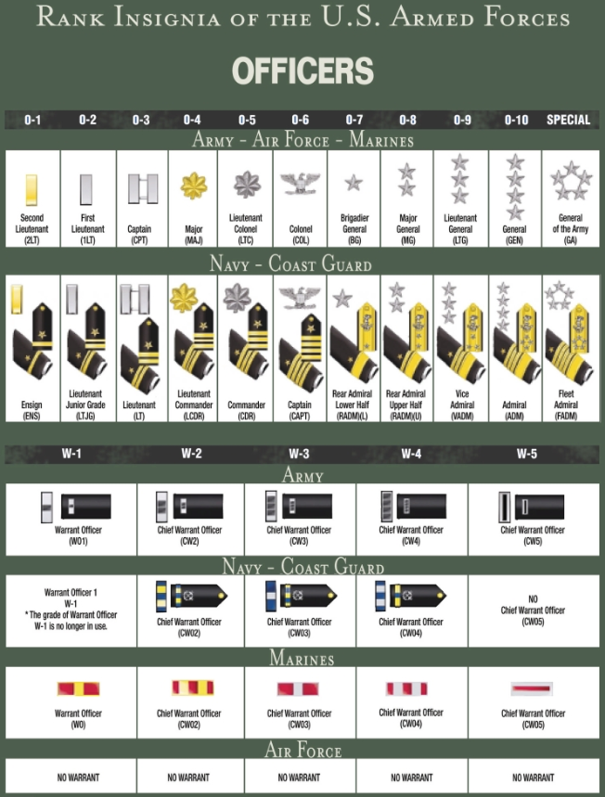

Slide 15
Military Functions

Slide 16
Common Functions
Supply Corps / Quarter Master / Battalion S4 / Movement / Acquisition / Transportation
Aerospace Maintenance / Armor / Engineering / Surface Warfare / Combat Arms / Ordnance / Munitions / Civil Engineer
Infantry / Field Artillery / Air Defense Artillery / Armor / Security / Recruiting / Safety
Administrative / Civil Affairs / Finance Corps / Public Affairs / Communications
Signal Corps / Communications / Information Technology / Electronic Warfare / Cyber-technology / Intel / Space Missile Control / Operations

Slide 17
Military Status & Discharge Definitions

Slide 18
Military Status
Status | Definition
Active | Full time federal government employee serving in one of the 5 branches of the armed forces.
Deployed | Generally when a service member is not stationed at their home base. (i.e. field training, combat, humanitarian aid)
National Guard/Reserve | Part - time (typically 1 weekend per month) employee of the state or federal government.

Slide 19
Military Discharge Types
Status | Definition
Honorable | Service member must have received a rating from good to excellent for his or her service.
General | Performance is satisfactory but is marked by a considerable departure in duty performance and conduct expected of military members.
Other than Honorable | Represents a departure from the conduct and performance expected of all military members.
Bad Conduct | Given by a court-martial as punishment to an enlisted service-member. Bad conduct discharges are often preceded by a period of confinement in a military prison.
Dishonorable | Handed down for what the military considers the most reprehensible conduct.
Note: It is generally illegal to ask about applicant discharge status, unless to determine qualification for Veterans preference.

Slide 20
Job Transition Timeline

Slide 21
Civilian Job Preparation
2 years prior
Predict separation date from Military
1 year prior
Career transition assistance programs
6 months prior
Begin applying for positions
3 months prior
Secure civilian employment

Slide 22
Additional Resources
https://recruitmilitary.com/
https://www.veteranjobsmission.com/employers
https://www.military.com/hiring-veterans
https://www.dol.gov/veterans/hireaveteran/
https://www.onetonline.org/crosswalk/

