Slide 1
VA S.A.V.E. Training
Cassandra Meredith, LCSW, BCD
Suicide Prevention Community Engagement and Partnership Coordinator
VA Northern California Healthcare System
Cell: 916-717-3479
Cassandra.meredith@va.gov

Slide 2
Before We Begin:
Suicide is an intense topic for some people.
  If you need to take a break, or step out, please do so.
  Immediate Resources:
    National Suicide Prevention Lifeline: 1-800-273-8255
      Service members and Veterans: Press 1 to connect with the Veterans Crisis Line.
    Employee Assistance Program (EAP):
      www.FOH4YOU.com
      1-800-222-0364
Notes:
Today we will discuss ways that everyone can contribute to a safer environment for Veterans at risk for suicide. We understand that this is a sensitive topic and that people in attendance today may have had personal experiences involving suicide. If you find you need to take a break, please do so. Feel free to reach out to me at the end of the presentation if you need support. If you find you need to talk to someone at any time, you can call the National Suicide Prevention Lifeline at 1-800-273-8255 (service members and Veterans should press 1 to connect with the Veterans Crisis Line). Why don’t we all put this number into our phone contacts right now?

Slide 3
Overview
Objectives
Facts about Veteran Suicide
VA S.A.V.E. Steps
Resources
Notes:
This program is focused on preventing suicide attempts and saving lives that might otherwise be lost to suicide. It is designed to train everyone who knows a Veteran to be a “gatekeeper.” The role of gatekeepers is connecting those at risk for suicide with people who can help them. You can save lives by being sensitive to people in distress and by connecting them with care.

Slide 4
Objectives
By participating in this training, you will:
Have a general understanding of the scope of Veteran suicide within the United States.
Know how to identify a Veteran who may be at risk for suicide.
Know what to do when you identify a Veteran at risk.

Slide 5

Take a moment to consider:
What are your biggest questions around suicide and talking to people in crisis?

Slide 6
Facts About Veteran Suicide

Slide 7
Suicide is a National Public Health Problem
Suicide is a national issue, with rising rates of suicide in the general population.
For every death by suicide, approximately 135 individuals are impacted.
Notes:
Suicide is a national issue, with rising rates of suicide in the general population. In addition, suicide rates are higher, and are rising faster, among Veterans than among non-Veteran adults.
Societal factors, such as economic disparities, race/ethnicity/LGBT disparities, homelessness, social connection and isolation, and health and well-being, play additional roles in suicide.
Coronavirus Disease 2019 (COVID-19) pandemic has also placed additional strain on our Nation and on individuals and communities
Our nation grieves with each suicide, necessarily prompting the collective tireless pursuit of evidence-based clinical interventions and community prevention strategies, critical to the implementation of VA’s National Strategy for Preventing Veteran Suicide.
Cerel, J., Brown, MM., Maple, M., Singleton, M., van de Venne, J, Moore, M., & Flaherty, C., How many people are exposed to suicide? Not six. Suicide and Life-Threatening Behavior, (2018) https://doi.org/10.1111/sltb.12450
Turecki, G., Brent, D.A. (2016) Suicide and suicidal behavior. Lancet. 387:12271,227–39.
Zalsman G., Hawton, K., Wasserman, D., van Heeringen, K., Arensman, E., Sarchiapone, M., … Zohar, J. (2016) Suicide prevention strategies revisited: 10-year systematic review. Lancet. 3:646–59.
Department of Veterans Affairs (2018). National Strategy for Preventing Veteran Suicide. Washington, DC. Available at https://www.mentalhealth.va.gov/suicide_prevention/docs/Office-of-Mental-Health-and-Suicide-Prevention-National-Strategy-for-Preventing-Veterans-Suicide.pdf.

Slide 8
Suicide is a Complex Issue with No Single Cause
Suicide is often the result of a complex interaction of risk and protective factors at the individual, community, and societal levels.
Risk factors are characteristics that are associated with an increased likelihood of suicidal behaviors. Protective factors can help offset risk factors.
To prevent Veteran suicide, we must maximize protective factors while minimizing risk factors at all levels, throughout communities nationwide.

Slide 9
Risk and Protective Factors
Risk
Protective
Prior suicide attempt
Mental health issues
Substance abuse
Access to lethal means
Recent loss
Legal or financial challenges
Relationship issues
Unemployment
Homelessness
Access to mental health care
Sense of connectedness
Problem-solving skills
Sense of spirituality
Mission or purpose
Physical health
Employment
Social and emotional well-being
Goal: Minimize risk factors and boost protective factors
Notes:
Risk factors are characteristics that are associated with an increased likelihood of suicidal behaviors. Some risk factors for suicide include: prior suicide attempt history, certain mental health conditions, access to lethal means, and stressful life events, such as divorce, job loss, or the death of a loved one.
Protective factors can help offset risk factors. These are characteristics associated with a decreased likelihood of suicidal behaviors. Some protective factors for suicide include access to mental health care, feeling connected to other people, and positive coping skills.

Slide 10
Key Findings:
2021 National Veteran Suicide Prevention Annual Report

Slide 11
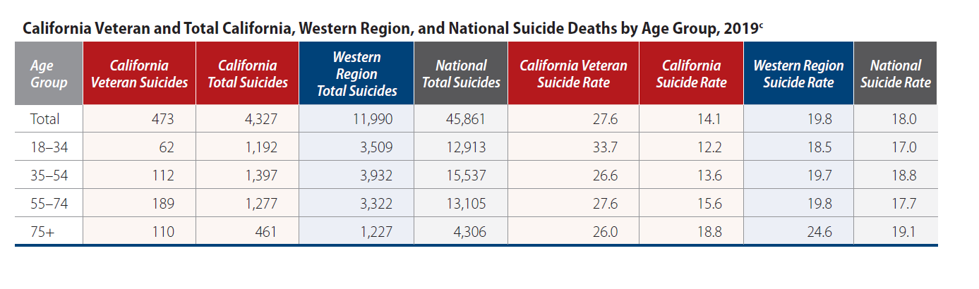
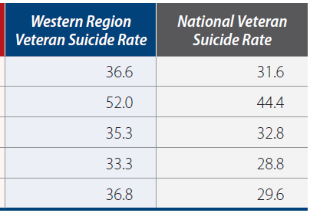
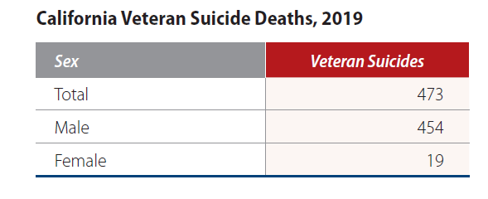
California Data

Slide 12
Veteran Suicide Deaths, 2001-2019
In 2019, the number of Veteran suicides (6,261) was the lowest since 2007.
Notes:
6,261 Veterans died by Suicide in 2019 compared with 6,660 in 2018
Veterans accounted for 5,989 suicides in 2001, which represented 20.2% of suicides among U.S. adults in 2001; and 6,261 suicides in 2019, which, by comparison, represented 13.7% of suicides among U.S. adults in 2019.

Slide 13
Age and Sex-Adjusted Suicide Rates,
Veterans and Non-Veteran US Adults, 2001-2019
Notes:
From 2018 to 2019, changes in age- and sex-adjusted suicide mortality rates: Veterans - 7.2% decrease, Non-Veteran US adults - 1.8% decrease.

Slide 14
Notes:
In 2019, adjusted suicide rates were 152% greater for Veteran men than Veteran women.
Rates for Veteran men were highest in 2018 (40.4/100,000) and fell 3.8% in 2019 (38.8/100,000)
Rates for Veteran women were highest in 2017 (19.9/100,000) and fell in 2018 (18.1/100,000) and again in 2019 (15.4/100,000), which represented a 14.9% decrease relative to 2018.

Slide 15
Percentage of Suicide Deaths and Methods Involved, 2019
Firearms accounted for 70.2% of male Veteran suicides in 2019 (up from 69.6% in 2018) and 49.8% of female Veteran suicides in 2019 (up from 41.1% in 2018).

Slide 16
What is Lethal Means Safety?
In the context of suicide prevention, safe storage of lethal means is any action that builds in time and space between a suicidal impulse and the ability to harm oneself.
Effective lethal means safety education and counseling is collaborative and Veteran-centered. It respects the important role that firearms and medications may play in Veterans’ lives and is consistent with their values and priorities.

Slide 17
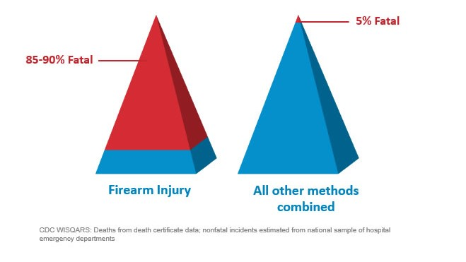
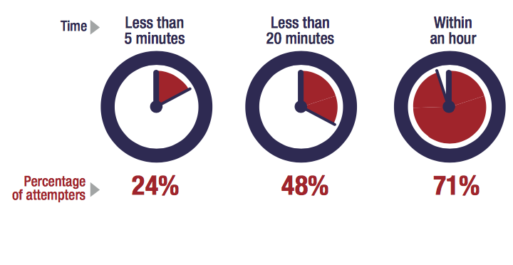
Most Suicidal Crises are Brief
Time from Decision to Action < 1 hour
Source: Simon, T.R., Swann, A.C., Powell, K.E., Potter, L.B., Kresnow, M., and O’Carroll, P.W. Characteristics of Impulsive Suicide Attempts and Attempters. SLTB. 2001; 32(supp):49-59.
Source: CDC WISQARS and US Dept. of Veterans Affairs
https://www.mirecc.va.gov/lethalmeanssafety/facts/
Notes:
Building in time and space between the impulse to act and the means to harm one’s self saves lives.
While some suicidal crises last a long time, most last minutes to hours. In one study of suicide attempt survivors:
47 percent said it took less than one hour between their decision to attempt suicide and their actual attempt.
24 percent said it took less than five minutes for them to act.
The time between when a person decides to die by suicide and they act on the decision is often very short. A 2005 study found that 71% of attempters estimating that the process took less than an hour. This reality underscores the importance of reducing access to means for those who are at elevated risk for suicide, until the risk period passes.
Access to lethal means increases suicide risk for everyone living in the home
Acute phase of a suicidal crisis is often brief.
Building in time and space—even 30-60 minutes—between impulse to act and the means to harm one’s self saves lives
We know that people rarely “substitute” one means for another. So, it is important to restrict whichever means they have in mind to use.
Means matter—how a person attempts suicide impacts how fatal the injury will be.
About 90% of firearm-related suicide attempts are fatal, as compared to approximately 5% of suicide attempts by all other mechanisms combined
Most who survive a nonfatal suicide attempt do not go on to die by suicide
Building in time and space between the impulse to act and the means to harm one’s self saves lives.
While some suicidal crises last a long time, most last minutes to hours. In one study of suicide attempt survivors:
47 percent said it took less than one hour between their decision to attempt suicide and their actual attempt.
24 percent said it took less than five minutes for them to act.

Slide 18
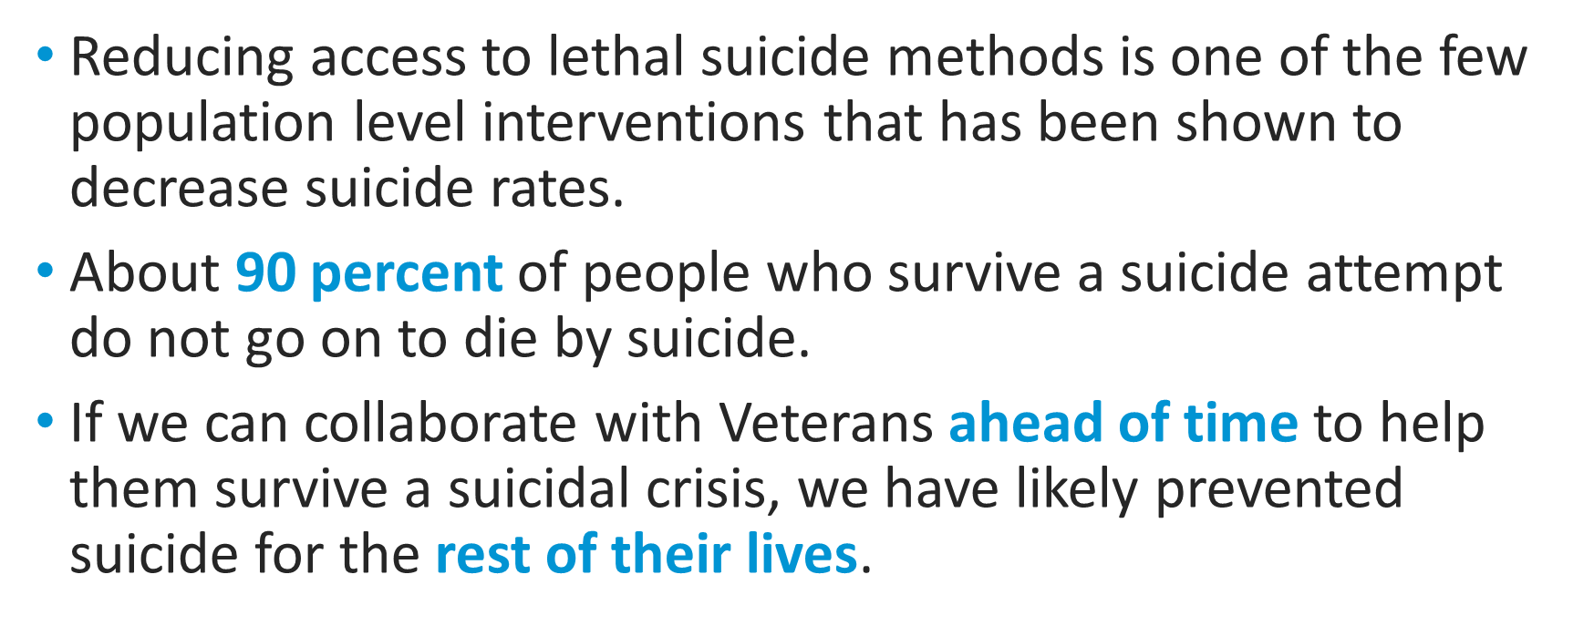
Lethal Means Safety Works
Notes:
In 1997, Australia instituted stricter gun safety measures, including minimum age restrictions, psychological evaluations, background checks, and waiting periods. The firearm suicide rate steadily declined by 4.7% each year, and researchers did not see a substitution effect.
The Israeli Defense Force saw a 40% reduction in the suicide rate among soldiers when it restricted soldiers’ access to firearms during weekend leave.
Firearm-related suicides in Indiana and Connecticut declined after those states enacted legislation allowing law enforcement officers to seize firearms from individuals they deem a risk to themselves or others.
Full citations:
- Kapusta, N. D., Etzersdorfer, E., Krall, C., & Sonneck, G. (2007). Firearm legislation reform in the European Union: Impact on firearm availability, firearm suicide and homicide rates in Austria. The British Journal of Psychiatry, 191(3), 253–57.
- Lubin, G., Werbeloff, N., Halperin, D., Shmushkevitch, M., Weiser, M., & Knobler, H. Y. (2010). Decrease in suicide rates after a change of policy reducing access to firearms in adolescents: A naturalistic epidemiological study. Suicide and Life-Threatening Behavior, 40(5), 421–24.
- Kivisto, A. J., & Phalen, P. L. (2018). Effects of Risk-Based Firearm Seizure Laws in Connecticut and Indiana on Suicide Rates, 1981–2015. Psychiatric Services, 69, 855–62.

Slide 19
Suicide is preventable.
Notes:
Suicide is preventable, and preventive treatment works. Every day, people across the nation reach out for support and are able to live healthy, productive lives.

Slide 20
Common Myths vs. Realities
Notes:
Even though suicide is a major public health concern, there are a lot of common myths and misinformation about suicide. Let’s talk about some of these. Having accurate information about suicide makes it easier to reach out to others and help them.

Slide 21

Common Myths vs. Realities
Myth
Reality
People who talk about suicide are just seeking attention.

Slide 22

Common Myths vs. Realities
Myth
Reality
No matter how casually or jokingly said, suicide threats should never be ignored and may indicate serious suicidal feelings. Someone who talks about suicide provides others with an opportunity to intervene before suicidal behaviors occur.

Slide 23
Common Myths vs. Realities
Myth
Reality
The only one who can really help someone who is suicidal is a mental health counselor or therapist.

Slide 24
Common Myths vs. Realities
Myth
Reality
Special training is not required to safely raise the subject of suicide. Helping someone feel included and showing genuine, heartfelt support can also make a big difference during a challenging time.

Slide 25
The Steps of VA S.A.V.E.

Slide 26
VA S.A.V.E.: Teaching Communities How to Help Veterans at Risk for Suicide
VA S.A.V.E. will help you act with care and compassion if you encounter a Veteran who is in suicidal crisis.
Signs of suicidal thinking should be recognized.
Ask the most important question of all.
Validate the Veteran’s experience.
Encourage treatment and Expedite getting help.

Slide 27

Signs of Suicidal Thinking
Learn to recognize these warning signs:
Hopelessness, feeling like there is no way out
Anxiety, agitation, sleeplessness, or mood swings
Feeling like there is no reason to live
Rage or anger
Engaging in risky activities without thinking
Increasing alcohol or drug use
Withdrawing from family and friends

Slide 28
Signs of Suicidal Thinking
The presence of any of the following signs requires immediate attention:
Thinking about hurting or killing themselves
Looking for ways to die
Talking about death, dying, or suicide
Self-destructive or risk-taking behavior, especially when it involves alcohol, drugs, or weapons

Slide 29

Asking the Question
Know how to ask
the most important question of all…

Slide 30
Asking the Question
“Are you thinking about killing yourself?”

Slide 31
Asking the Question
Do’s | Don’ts
DO ask the question if you’ve identified warning signs or symptoms. | DON’T ask the question as though you are looking for a “no” answer. “You aren’t thinking of killing yourself, are you?”
DO ask the question in a natural way that flows with the conversation. | DON’T wait to ask the question when someone is halfway out the door.
Notes:
Use direct words and phrases, such as “killing yourself” and “suicide,” when asking about suicidal thoughts. Avoid using vague phrases such as “hurting yourself,” as these can have different meanings to different people. To emphasize this point, you can ask participants why it is so important to ask this question directly instead of indirectly. What may be the outcome of asking indirect questions? (Answer: indirect answers!)
Ask a direct question if warning signs (“invitations”) are evident. When “invitation statements” have been made, it can be helpful to use them as springboards to directly ask about a person’s risk for suicide. (E.g., “I want to better understand what you mean by ‘ending it all.’ Are you thinking about killing yourself?”)
Phrase questions in a way that indicates openness to listening and remain nonjudgmental no matter the answer. This is extremely important, as it will help the Veteran understand that people are willing to listen.
The question should not be an afterthought. It should be asked promptly once someone indicates that they may be at risk for suicide.
There may not be an optimal time to ask the question, and doing so may be discomforting. Acknowledge this and encourage participants to ask the question anyway.

Slide 32
Asking the Question: Check-In & Practice
What are your thoughts about “Asking the question”?
What initial concerns do you have?

Slide 33

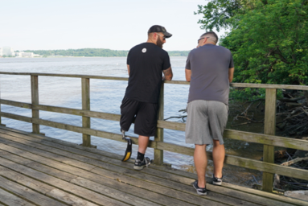
Validate the Veteran’s Experience
Talk openly about suicide. Be willing to listen and allow the Veteran to express his or her feelings.
Recognize that the situation is serious.
Do not pass judgment.
Reassure the Veteran that help is
available.

Slide 34
Validate the Veteran’s Experience: Check-In & Practice
Who can share a validating statement?
Turn to a partner and practice the following:
  In response to an “invitation statement” such as, “Everything is so hard. I feel like a drag on my friends.”
    Start by telling your partner, “Everything will be fine.” (Partner should respond.)
    Shift instead to a statement that validates their feelings. (Partner should respond.)
What did you notice?
Notes:
Examples of validating statements include:
“Anyone in your situation would feel that way.”
“Of course you’re overwhelmed.”
“You have been struggling with a lot.”
“This would be too much for anyone to handle.”
Direct participants to turn to a partner and practice the following, in response to an “invitation statement” such as, “Everything is so hard. I feel like a drag on my friends”:
Start by telling your partner, “Everything will be fine.” (Partner should respond.)
Shift instead to a statement that validates their feelings. (Partner should respond.)
Pause to have participants reflect on the exercise. Ask: What did you notice?

Slide 35
When Talking with a Veteran at Risk for Suicide
Remain calm.
Listen more than you speak.
Maintain eye contact.
Act with confidence.
Do not argue.
Use open body language.
Limit questions — let the Veteran do the talking.
Use supportive, encouraging comments.
Be honest — let the Veteran know that there are no quick solutions, but help is available.
Notes:
Open body language signals interest in the other person and in the conversation. Maintain a relaxed posture, lean in closer, use direct eye contact, and nod in agreement to show your Veteran that you’re present in the moment with them.

Slide 36

Encourage Treatment and Expedite Getting Help
What should I do if I think someone is suicidal?
  Don’t keep the Veteran’s suicidal behavior a secret.
  Do not leave him or her alone.
  Try to get the person to seek immediate help from his or her doctor or the nearest hospital emergency room.
  Call 911.
Reassure the Veteran that help is available.
Call the Veterans Crisis Line at 1-800-273-8255 and Press 1.
Notes:
No keeping secrets- if someone says they will talk to you about an issue “only if you promise not to tell anyone,” it’s important to be up front in saying you cannot make that promise because you care about them and want them to get any help that they may need. You don’t want to keep a secret and regret it.

Slide 37
What to Do if a Veteran Expresses Suicidal Ideation During a Phone Call
Keep the caller on the line (do not hang up or transfer).
Remain calm.
Obtain identifying information on the caller (name, phone number, and current location).
Conference call to VCL (don’t hang up until VCL responder has the call).
Enlist co-workers for assistance via Instant Messaging in Teams.
If caller disconnects, call back immediately. If no answer, dial 911 and VCL (1-800-273-8255 and Press 1.).
Tip: Practice conferencing in calls at your desk with coworkers.

Slide 38
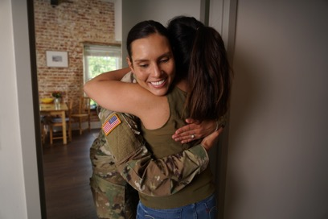
Practice Sessions
Goal: To develop a level of comfort and confidence in asking about suicide and helping a Veteran who is thinking about suicide.
Notes:
[Practice Sessions are a chance to practice VA S.A.V.E. skills. Encourage everyone to participate, but don’t worry if someone does not want to do it. It’s okay if they want to just watch. Flexibility is a strength here.
Depending on your group(s) and your time, you can have 1 or more role plays with a volunteer, or brainstorm role play responses with the whole group.
Use that attached role play materials to help your colleagues practice VA S.A.V.E. Keep slide 36 with the steps of VA S.A.V.E. visible for people to use.
Be positive and encouraging. Take a gentle, coaching approach. This is a sensitive issue, and a new skill for many people. If you mean well, and are doing your best, with VA S.A.V.E. skills, it will likely work out well.
Wrap up during last 5 min of the hour.

Slide 39
Practice Sessions
Imagine that you are talking to a friend, family member, or co-worker whom you know well. You also know this person has been having a lot of personal problems lately and seems to be withdrawing from activities, and overall seems “down” much of the time. They mention that everything feels “hopeless.”
Step 1: As you begin your conversation with them, listen for the problems that they believe suicide would solve and listen for a sign — an invitation statement. When you hear a warning sign, find a way to ask the question, e.g., “You seem very overwhelmed right now. Are you thinking about suicide?”
Step 2: As you listen, make sure to validate their experience or feelings. Continue to listen and try to expedite them to the appropriate level of care.
Switch roles.

Slide 40
Remember
VA S.A.V.E.
  S
  A
  V
  E
  Signs of suicidal thinking should be recognized.
  Ask the most important question of all.
  Validate the Veteran’s experience.
  Encourage treatment and Expedite getting help.

Slide 41
Signs of Suicidal Thinking
What signs did you identify?

Slide 42
Asking the Question
What did you notice about your “ask”?

Slide 43
Validate the Veteran’s Experience
What did your partner do or say that was validating?

Slide 44
Encourage Treatment and Expedite Getting Help
What did you do to expedite getting help?
How comfortable would you be recommending resources?

Slide 45
Debrief
Thought, feelings, or questions about the exercise?
Notes:
The nice thing about VA S.A.V.E. training is that no one expects you or me to have all the answers. The Suicide Prevention Program is happy to follow up with you about any outstanding questions you may have.

Slide 46
Suicide Prevention 2.0
Public Health Strategy

Slide 47
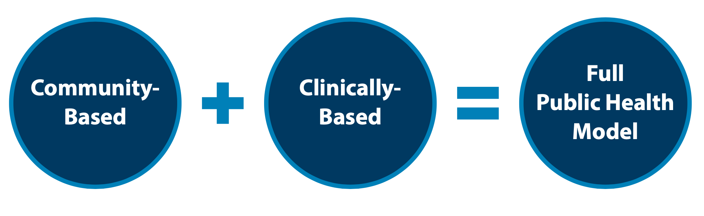
Public Health Strategy
VA's public health strategy combines partnerships with communities to implement tailored, local prevention plans while also focusing on evidence based clinical strategies for intervention. Our approach focuses on both what we can do now, in the short term, and over the long term, to implement VA’s National Strategy for Preventing Veteran Suicide.
Notes:
Suicide is a public health challenge that causes far-reaching pain among individuals, families, and communities across the country. Suicide is also preventable. Veteran suicide is an urgent issue that the U.S. Department of Veterans Affairs (VA), along with its stakeholders, partners, and communities nationwide, must address. VA supports the national goal of reducing the annual suicide rate in the U.S. by 20 percent by the year 2025 and is implementing a public health approach to achieve this mission.
In 2020, VA translated the vision offered by the 10-year National Strategy and its four major domains into operational plans of actions through the Suicide Prevention 2.0 initiative (SP 2.0). SP 2.0 focuses on nationally implementing and operationalizing across a 6-year period new and bundled community-based and clinically based services and programs reflective of the National Strategy to expand VA’s approach to prevent Veteran suicide nationwide. SP 2.0 aligns suicide prevention, intervention, and postvention goals across clinical and community settings to reach and serve Veterans both within and outside VHA clinical care at national, state, and local levels.

Slide 48
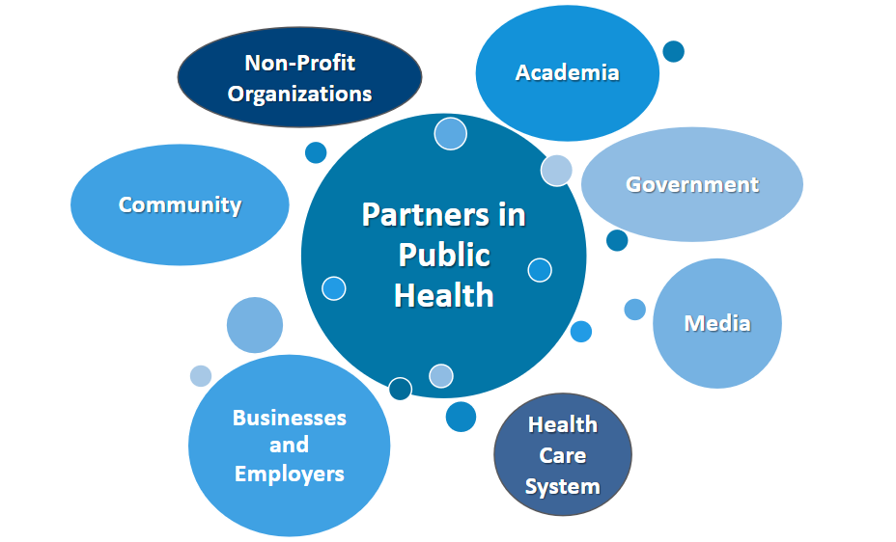
Suicide Prevention is Everyone’s Business
Notes:
Veterans do not live, work, and serve in isolation from the community, the nation, or the world. The issue of suicide in the U.S. also affects the Veteran population. That's why we are working with an extensive network of community partners across the country to prevent suicide among all Veterans including those who may never come to VA for care.
No one system can prevent suicide. It is a shared responsibility. As such, VA has embraced a comprehensive public health approach to reduce Veteran suicide rates, one that looks beyond the individual to involve peers, family members, and the community. Yet we know we cannot do it alone, as roughly half of all Veterans in the U.S. do not receive services or benefits from VA. This means we must collaborate with partners and communities nationwide to use the best available information and practices to support all Veterans, whether or not they’re engaging with VA.
Recommend an upstream approach to suicide prevention; that is, rather than jumping in the river to rescue someone, try to reach them before they get in the water. An upstream approach requires less resources and less energy and can reach more people. The hardest time to intercept someone is when they are already in a state of crisis so in the slides to follow, we will address this public health strategy and the programming to make it possible.

Slide 49
Resources
Notes:
Customize the Resources section based on your audience

Slide 50
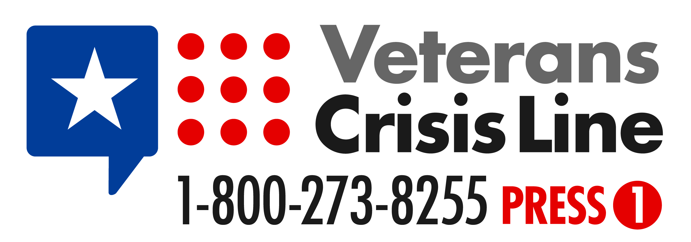
Free, Confidential Support 24/7/365
Veterans
Service members
Family members
Friends
Notes:
Veterans Crisis Line: The Veterans Crisis Line connects Veterans in crisis and their families and friends with qualified, caring VA responders through a confidential toll-free hotline, online chat, or text. Veterans and their loved ones can call 1-800-273-8255 and Press 1, chat online, or send a text message to 838255 to receive confidential crisis intervention and support 24 hours a day, 7 days a week, 365 days a year. More information is available at https://www.veteranscrisisline.net/.

Slide 51
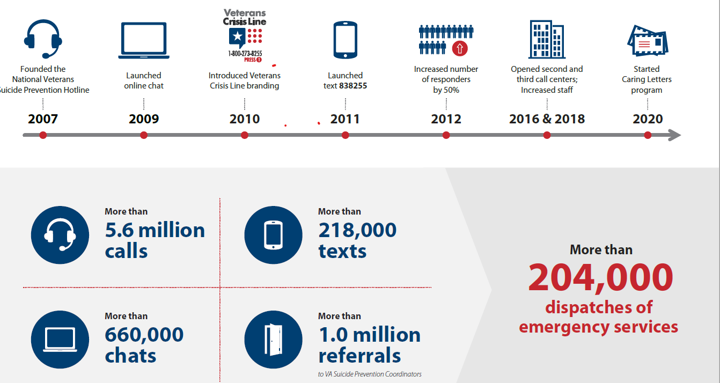

Slide 52
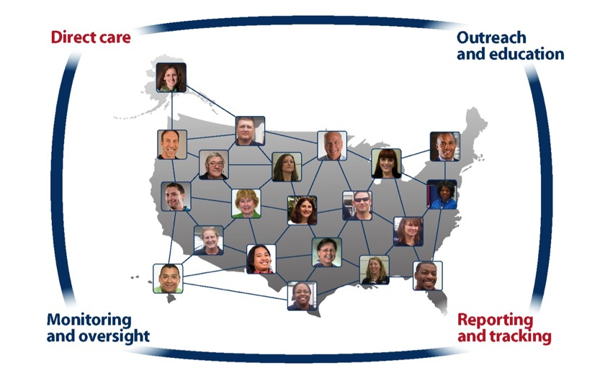
Find a Local VA SPC at VeteransCrisisLine.net/ResourceLocator
More than 400 SPCs nationwide.
Notes:
Resource Locator: This online resource helps Veterans easily find VA resources in their area including Suicide Prevention Coordinators, crisis centers, VAMCs, outpatient clinics, Veterans Benefits Administration offices, and Vet Centers. More information is available at: www.veteranscrisisline.net/ResourceLocator.

Slide 53

VeteransCrisisLine.net/ResourceLocator
Notes:
After using the Resource Locator to find your local SPC, you can call or email them for clinical support, SAVE training, or event support. This example displays results of a search for resources in Fargo, North Dakota, which connects visitors to SPC Tammy Monsebroten, pictured here.

Slide 54
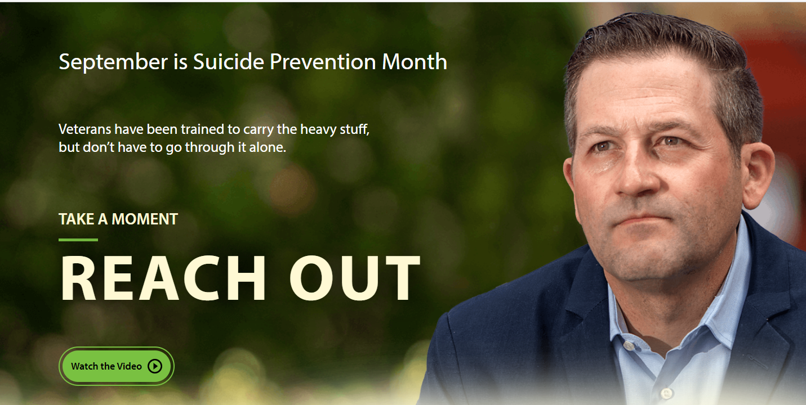
Take a Moment — Reach Out
Notes:
The Reach Out Campaign is rooted in the idea that during life changes, Veterans can practice upstream mental well-being and get support, and—in turn—supporters and stakeholders can be empowered to help Veterans going through a life challenge or tough time.
Suicide is a national, public health issue that affects all Americans, including Veterans, their families, and their friends. The U.S. Department of Veterans Affairs (VA) works to increase understanding about Veteran suicide prevention and the resources available to Veterans and their supporters and VA stakeholders and partners.
Reach Out is a new awareness campaign, which will launch at the beginning of Suicide Prevention Month on September 1. Reach Out will replace the current campaign, Be There
Messaging will also be focused on the role of Veteran supporters and VA stakeholders and partners in proactively reaching out to Veterans during life challenges

Slide 55
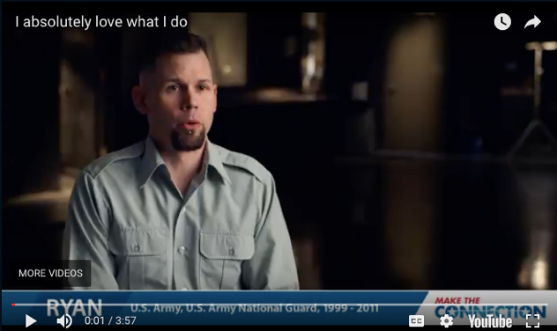
Make the Connection
Online resource featuring hundreds of Veterans telling their stories about overcoming mental health challenges.
https://maketheconnection.net/conditions/suicide
Notes:
Make the Connection: This online resource connects Veterans, their family members and friends, and other supporters with information and solutions to issues affecting their lives. More information is available at https://maketheconnection.net/.

Slide 56
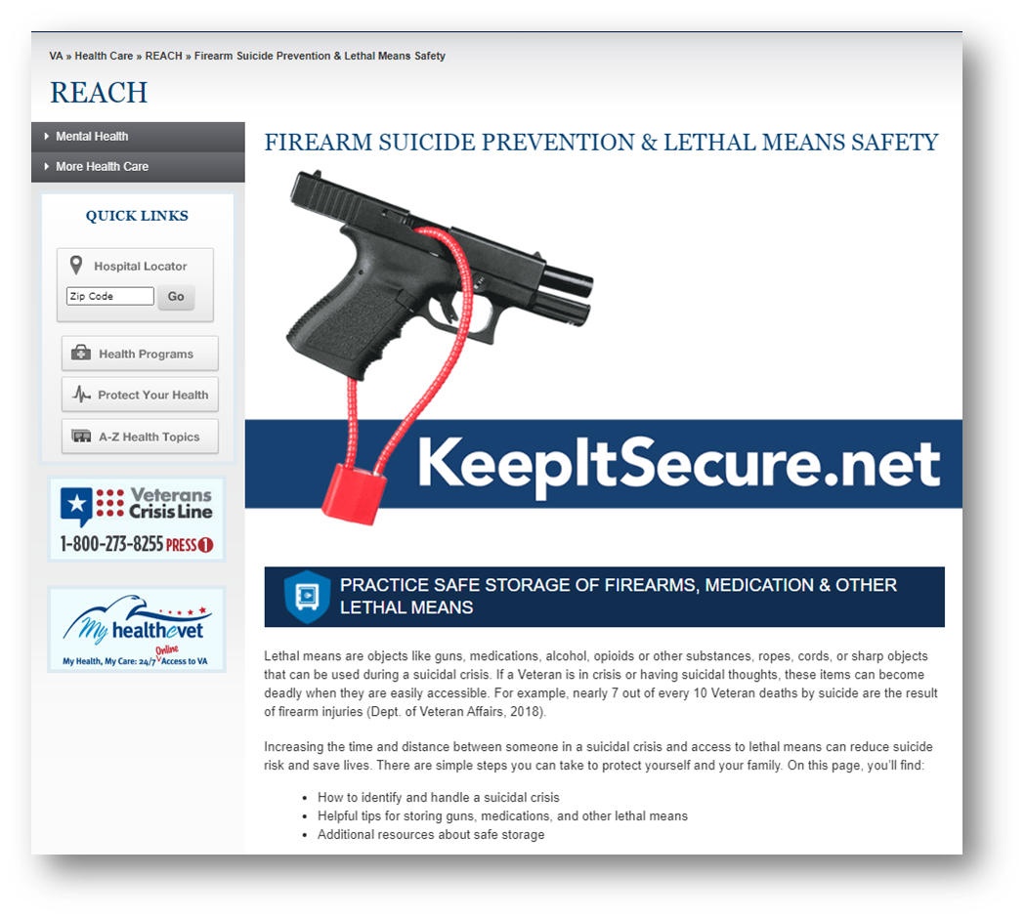
Practice safe storage of firearms, medications and other lethal means
Visit www.keepitsecure.net to learn more about the importance of firearm and other lethal means safety.
Nearly half of all Veterans own a firearm, and most Veteran firearm owners are dedicated to firearm safety.
Firearm injuries in the home can be prevented by making sure firearms are unloaded, locked, and secured when not in use, with ammunition stored in a separate location
There are several effective ways to safely secure firearms. Learn more and find the option that works best for you and your family from the National Shooting Sports Foundation at www.nssf.org/safety

Slide 57
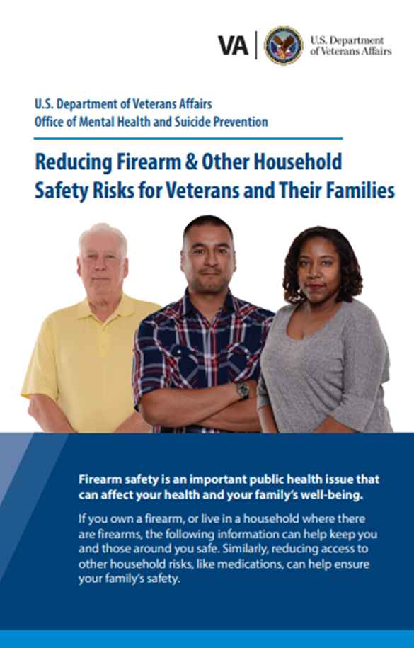
New Lethal Means Safety Resources
    Reducing Firearm & Other Household Safety Risks Brochure provides best practices for safely storing firearms and medications along with advice for loved ones on how to talk to the Veteran in their life about safe storage.

Slide 58
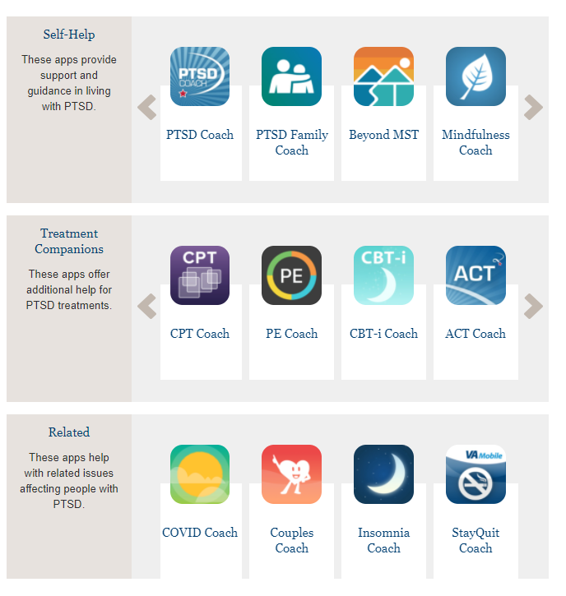
Mental Health Mobil Apps.
Mobile Apps - PTSD: National Center for PTSD (va.gov)

Slide 59
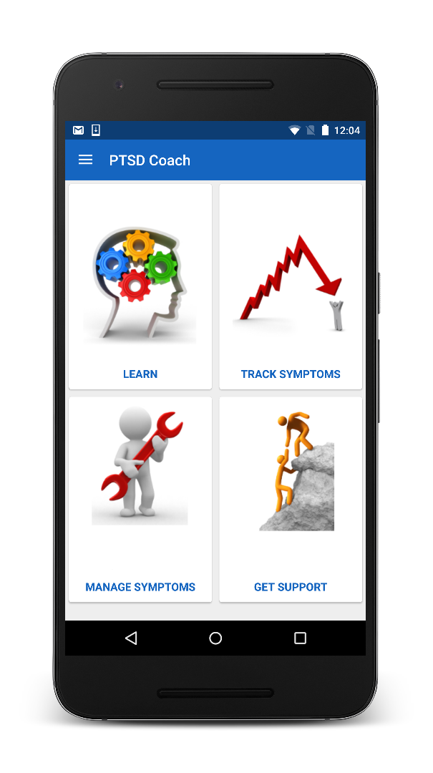
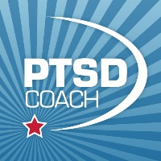
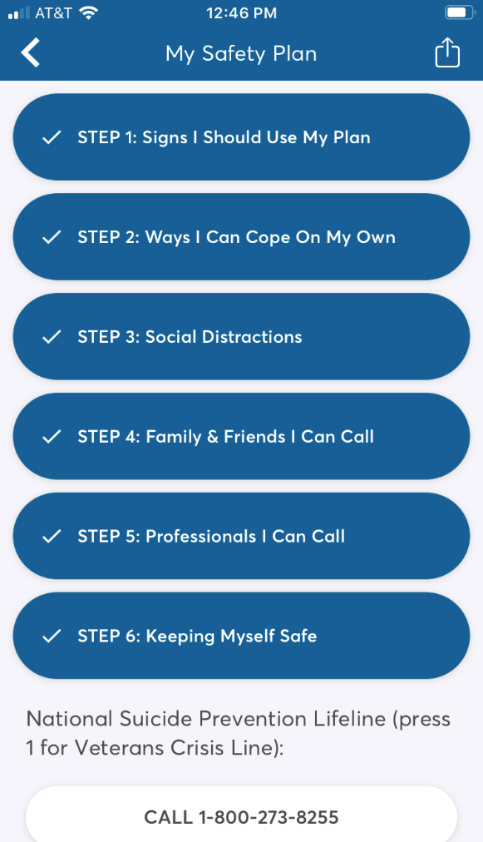
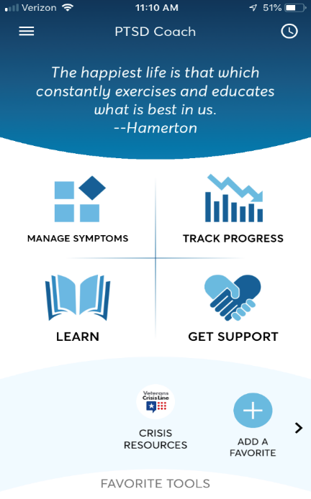
Safety Plan now in PTSD Coach!
To access the Safety Plan:
  Download* and open PTSD Coach
  Tap the lateral menu
  Tap Safety Plan
National Center for PTSD website:
https://www.ptsd.va.gov/appvid/mobile/ptsdcoach_app.asp
Notes:
The safety plan walks users through the creation of a detailed suicide safety plan. Users can create a safety plan on their own, with a provider, or with other supportive contacts.
The digital SP mirrors the paper plan currently being used. All of the steps, prompts, and resources on the paper plan are included in the digital version. The digital version even includes additional psychoeducational materials, which we’ll show you later.
Some may continue to have their plan on paper, and some may prefer to have it only on their phone. Some may want both! Hopefully by allowing them to access their plan in their preferred form, they may be more likely to keep it with them.

Slide 60
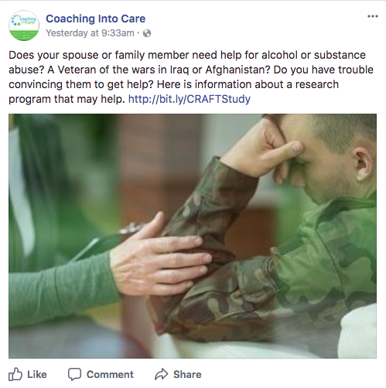
Coaching into Care
Program for families and loved ones of Veterans, helping them encourage the Veteran in their lives to seek support.
CALL 888-823-7458
Notes:
Coaching into Care (1-888-823-7458): A national telephone service of the VA, Coaching into Care aims to educate, support, and empower family members and friends who are seeking care or services for a Veteran. More information is available at https://www.mirecc.va.gov/coaching/.

Slide 61
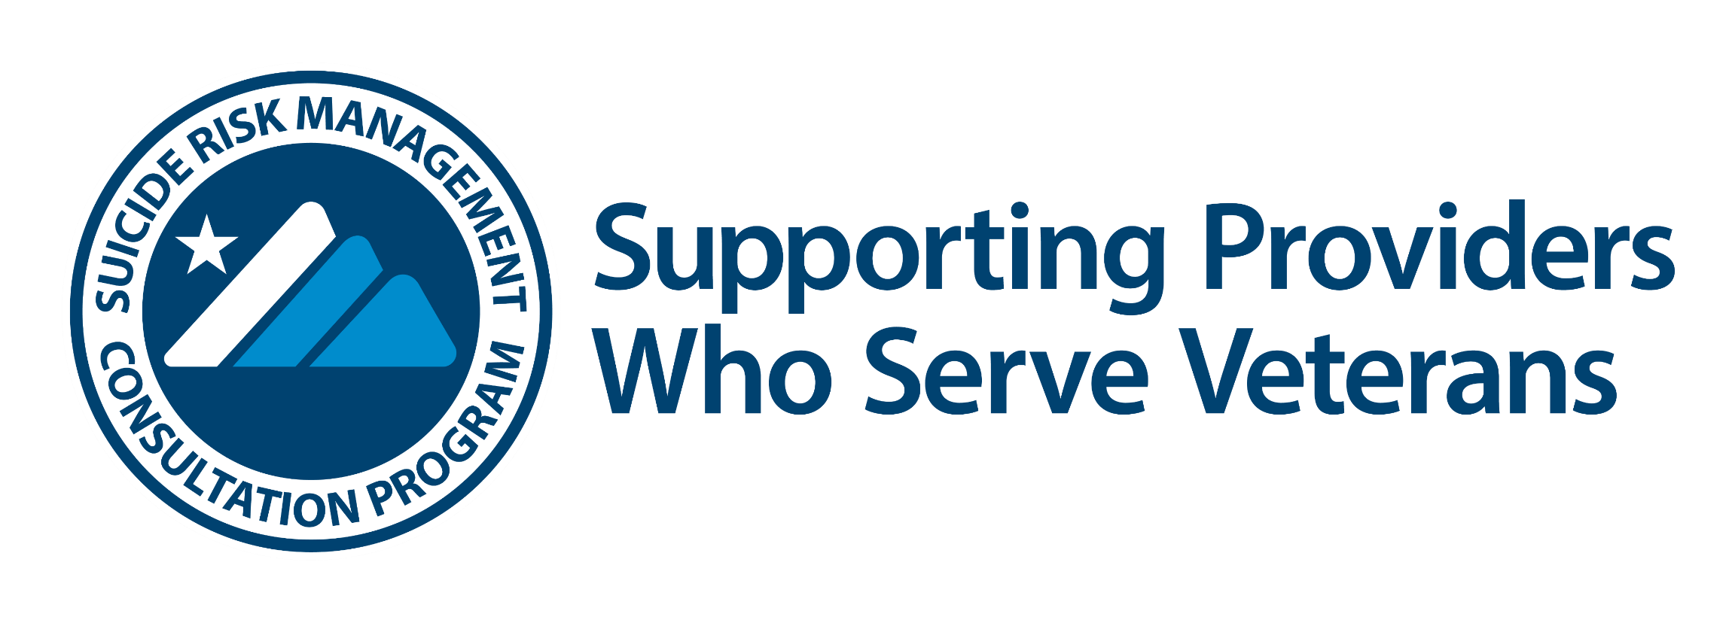






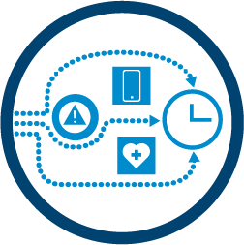
Provider support after a suicide
loss (Postvention)
Risk assessment
Free consultation and resources for any provider in the community or VA who serves Veterans at risk for suicide.
Request a consult: srmconsult@va.gov
Lethal means safety counseling
Conceptualization of suicide risk
Best practices for documentation
Strategies for how to engage
Veterans at high risk
www.mirecc.va.gov/visn19/consult

Slide 62





Postvention Resources
Uniting for Suicide Postvention (USPV): https://www.mirecc.va.gov/visn19/postvention/

Slide 63
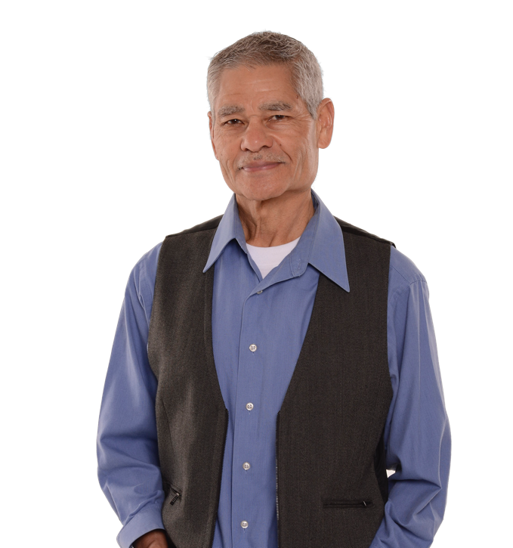
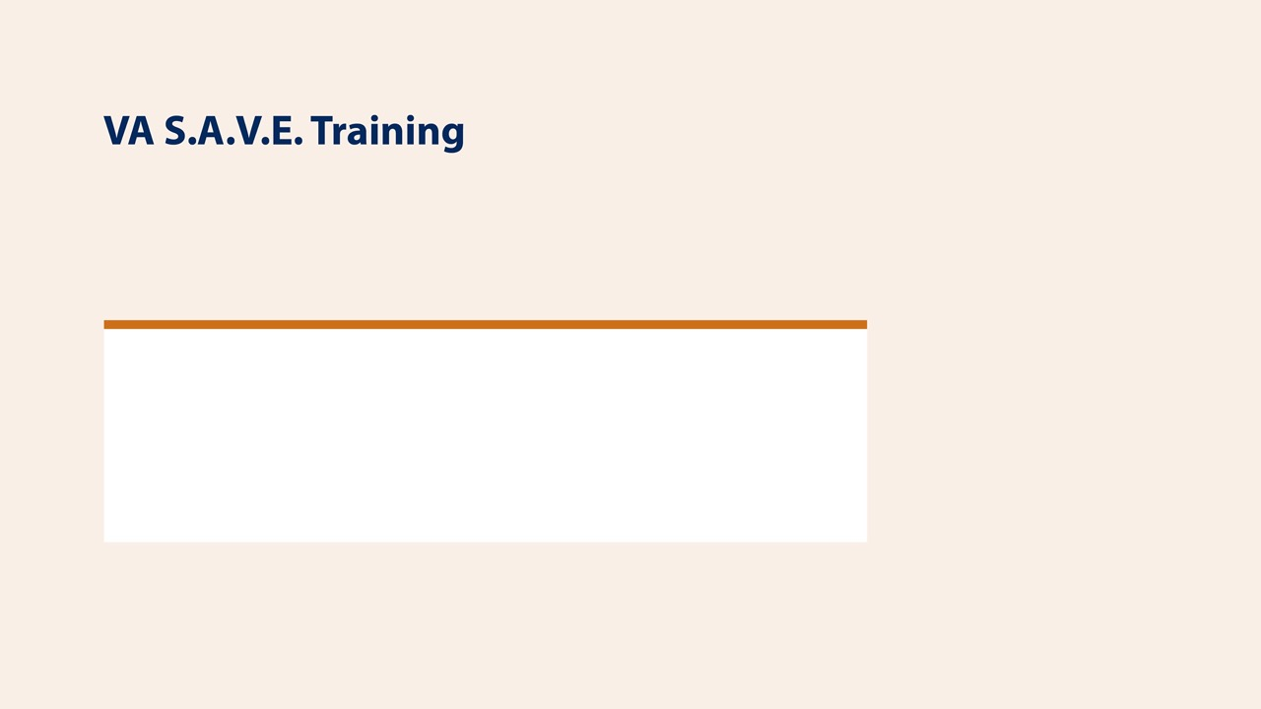

This free suicide prevention training video is less than 25 minutes long and available to everyone, 24/7. It's offered in collaboration with the PsychArmor Institute.
Available online for free: https://psycharmor.org/courses/s-a-v-e/

Slide 64
Questions?

